Slide 1

Predictive Model for Identifying Clutch Players – Project Charter
Welcome!
We're excited to present project charter for using data-driven way to
identify clutch players
for Toronto FC

Slide 2
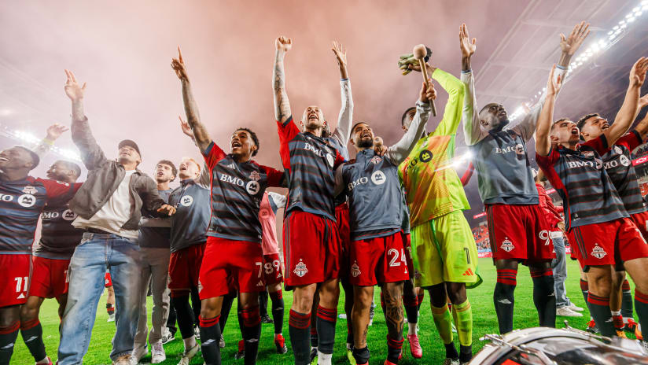



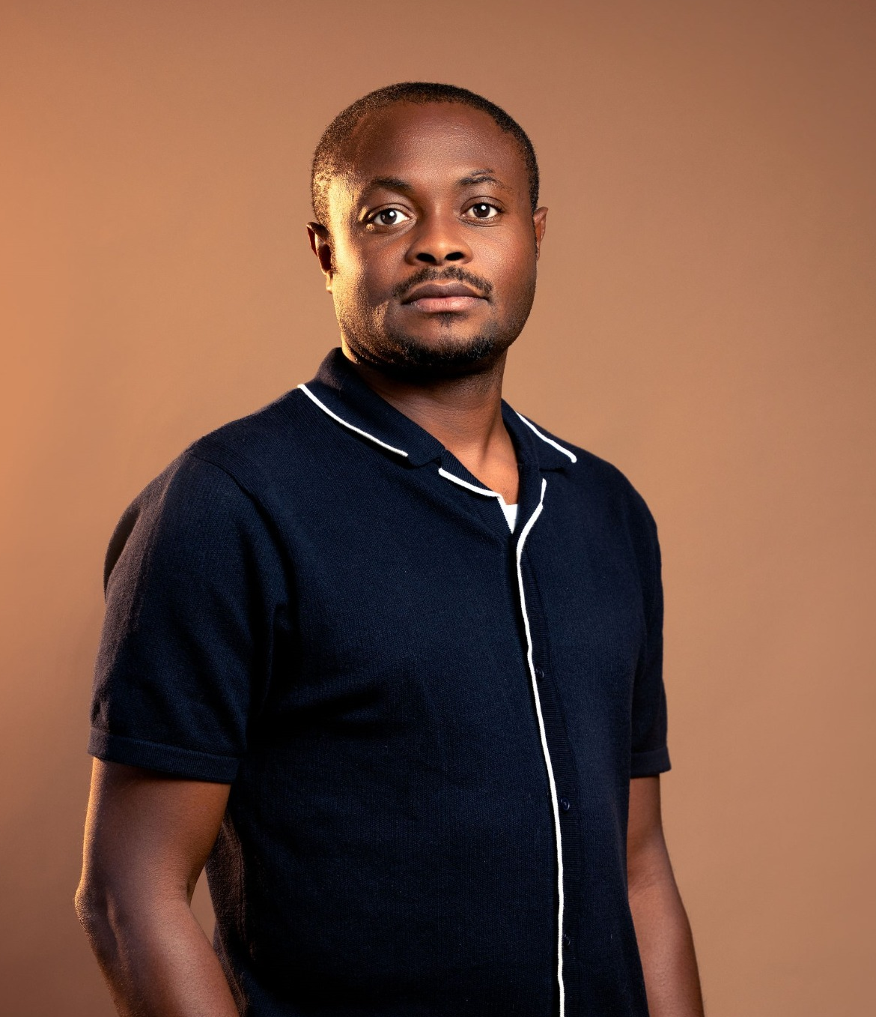

TEAM MEMBERS
Prescila Mora
Mohamed Afthab
Venkata Manish
Chibuike Okoroama

Slide 3
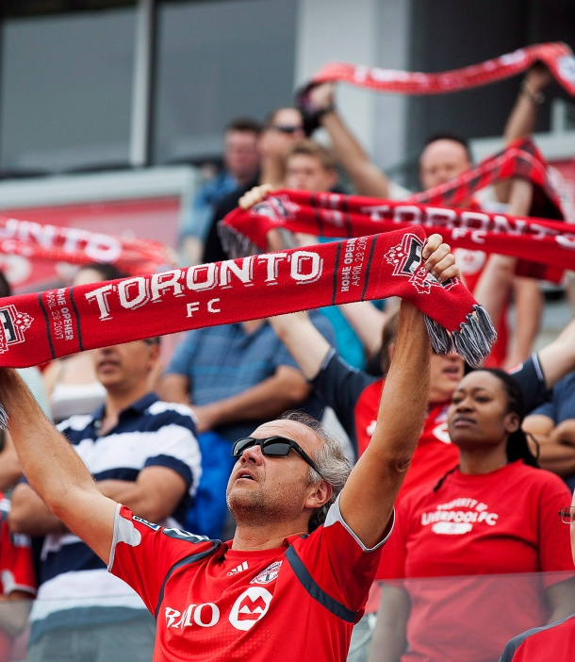
CLIENT
Name : Toronto FC (Football Club)
Location : Bay St. Toronto, Ontario
Phone : (416) - 360 - 4625
Team Worth : $ 690 M
Fan Base : Red Boys
Home Stadium : BMO Field, Toronto
Stadium Capacity : 30000+
League : Major League Soccer

Slide 4
AGENDA
Recap
Objective
Key Deliverables
Timeline
Risks and Mitigations
References

Slide 5

RECAP
AI-Driven Game Insights for Toronto FC
Objective: Use AI to analyze and improve game strategies for Toronto FC.
Key Focus Areas:
Player and team stats
Match context and trends
Predictive insights for tactical adjustments
Goal: Empower Toronto FC with data-driven strategies to enhance performance and competitive edge.

Slide 6
OVERVIEW
Purpose: Develop model to identify "clutch players“
Benefit: Inform strategic decisions for high-stakes moments
Impact: Enhance team performance and success
Notes:
This includes fostering a stronger emotional connection with the team, improving loyalty, encouraging repeat attendance, and ultimately, maximizing the team's revenue.
The model will focus on understanding fan behavior, optimizing stadium resources, and enhancing in-stadium and digital experiences.

Slide 7
OBJECTIVE & EXPECTED OUTCOMES
Build data-driven predictive model
Improve team lineup choices in critical situations
Increase team competitiveness in high-pressure games
Notes:
This includes fostering a stronger emotional connection with the team, improving loyalty, encouraging repeat attendance, and ultimately, maximizing the team's revenue.
The model will focus on understanding fan behavior, optimizing stadium resources, and enhancing in-stadium and digital experiences.

Slide 8
PROJECT RATIONALE
Clutch players excel under pressure
Valuable for decision-making in high-stakes games
Adds a data-driven edge to Toronto FC’s strategy
Notes:
Ticket Sales Records: Individual & season ticket sales, attendance patterns, seat preferences, no-show rates.
In-Stadium Interactions: Concession & merchandise purchases, kiosk interactions, gate entry/exit times, parking usage, fan engagement with in-game entertainment.
Social Media Interactions: Engagement on Twitter, Instagram, Facebook (hashtag usage, fan sentiment, polls, surveys).
Mobile App Data: In-app purchases, match updates, push notifications, fan content interactions.
In-Stadium Wi-Fi Data: Usage patterns, fan movement tracking, popular areas, peak times.
Surveys & Feedback: Fan surveys, feedback on the game-day experience, satisfaction reports.
Other Information: Weather, match outcomes, promotions, giveaways, fan demographics.

Slide 9
PROJECT SCOPE
Data Collection & Preprocessing
Model Development
Evaluation & Deployment
Notes:
The star schema consists of a central fact table that contains transactional data and multiple dimension tables that provide descriptive information about the data in the fact table.

Slide 10
KEY FEATURES
High-pressure scenario analysis
Machine learning to predict clutch players
Dashboard for coaching staff
Notes:
How This Data Structure Enhances the Game-Day Experience
Concrete Example: Personalized Fan Engagement
Let’s imagine Sarah, a season ticket holder, attends Toronto FC games regularly. She usually sits in section 105 and often purchases snacks at halftime using the stadium app. The data model can leverage her past interactions to enhance her future game-day experience.
Ticket Sales and Attendance Patterns: The fact table stores Sarah's season ticket information, tracking her attendance and seat preferences. Using this data, the model identifies that she prefers seats near the midfield and attends most home games. This can prompt the team to send her personalized offers for premium seats in her favorite section for high-profile matches.
Concession Purchases and App Data: Sarah frequently uses the stadium app to order food. The concession dimension shows that she orders nachos and a drink during halftime at every match. Based on this information, the app sends Sarah a pre-match offer for a discount on her usual order if she places it before the first half ends, reducing wait times at concession stands.
Social Media Engagement: Sarah is also active on Twitter, regularly posting about Toronto FC matches. The social media dimension tracks her positive engagement, and the marketing team notices she interacts frequently with posts about her favorite player, “Player X.” In response, the team sends Sarah a personalized notification during the next game, offering her a discount on a jersey for “Player X.”
Wi-Fi and Fan Movement: Based on Sarah’s Wi-Fi usage patterns, the model identifies that she frequently visits the fan zone at the west end of the stadium during halftime. Knowing this, the team could push promotions for activities or merchandise available in that area to enhance her in-stadium experience.
Operational Efficiency Example:
The match dimension includes historical data on weather conditions and fan attendance. If a rainy day is forecasted for the next game, the stadium management can adjust staffing levels at indoor concession stands based on insights from previous rainy matches. Similarly, they can promote indoor seating areas and provide fans with discounts on hot beverages, increasing comfort and sales during poor weather conditions.

Slide 11
POTENTIAL BENEFITS
Strategic player selection
Better team performance in critical moments
Strengthens data-driven culture in team
Notes:
How This Data Structure Enhances the Game-Day Experience
Concrete Example: Personalized Fan Engagement
Let’s imagine Sarah, a season ticket holder, attends Toronto FC games regularly. She usually sits in section 105 and often purchases snacks at halftime using the stadium app. The data model can leverage her past interactions to enhance her future game-day experience.
Ticket Sales and Attendance Patterns: The fact table stores Sarah's season ticket information, tracking her attendance and seat preferences. Using this data, the model identifies that she prefers seats near the midfield and attends most home games. This can prompt the team to send her personalized offers for premium seats in her favorite section for high-profile matches.
Concession Purchases and App Data: Sarah frequently uses the stadium app to order food. The concession dimension shows that she orders nachos and a drink during halftime at every match. Based on this information, the app sends Sarah a pre-match offer for a discount on her usual order if she places it before the first half ends, reducing wait times at concession stands.
Social Media Engagement: Sarah is also active on Twitter, regularly posting about Toronto FC matches. The social media dimension tracks her positive engagement, and the marketing team notices she interacts frequently with posts about her favorite player, “Player X.” In response, the team sends Sarah a personalized notification during the next game, offering her a discount on a jersey for “Player X.”
Wi-Fi and Fan Movement: Based on Sarah’s Wi-Fi usage patterns, the model identifies that she frequently visits the fan zone at the west end of the stadium during halftime. Knowing this, the team could push promotions for activities or merchandise available in that area to enhance her in-stadium experience.
Operational Efficiency Example:
The match dimension includes historical data on weather conditions and fan attendance. If a rainy day is forecasted for the next game, the stadium management can adjust staffing levels at indoor concession stands based on insights from previous rainy matches. Similarly, they can promote indoor seating areas and provide fans with discounts on hot beverages, increasing comfort and sales during poor weather conditions.

Slide 12
KEY DELIVERABLES
Project Charter
Data Report
Predictive Model
Dashboard Interface
Final Report
Notes:
The star schema consists of a central fact table that contains transactional data and multiple dimension tables that provide descriptive information about the data in the fact table.

Slide 13
TIMELINE
Planning
1 Week
Data Collection & Preprocessing
2 Weeks
Model Development
3 Weeks
Evaluation & Testing
2 Weeks
Integration & Review
1 Week
End of the Project
Notes:
The star schema consists of a central fact table that contains transactional data and multiple dimension tables that provide descriptive information about the data in the fact table.

Slide 14
RISKS & MITIGATIONS
Data Quality: Validate and clean data
Model Accuracy: Continuous testing and refinement
User Adoption: Training and demos for staff
Notes:
The star schema consists of a central fact table that contains transactional data and multiple dimension tables that provide descriptive information about the data in the fact table.

Slide 15
CONCLUSION
Data-driven model supports Toronto FC’s high-stakes decisions
Opportunity for strategic and competitive advantage
Ready to assist coaching team with predictive insights
Notes:
The star schema consists of a central fact table that contains transactional data and multiple dimension tables that provide descriptive information about the data in the fact table.

Slide 16
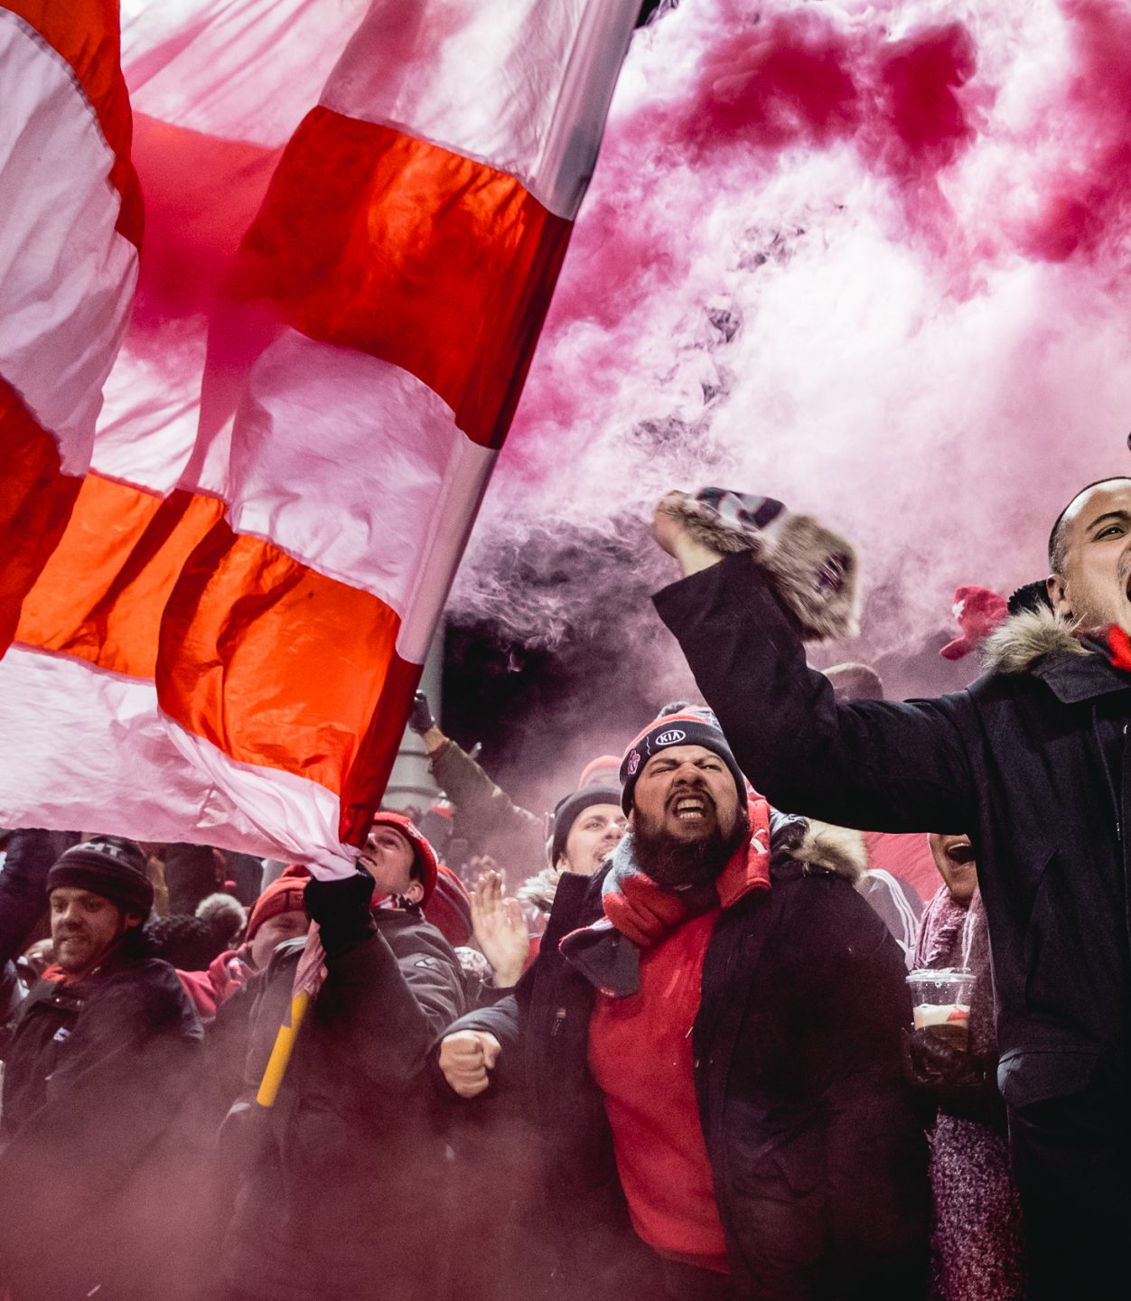
REFERENCES
MLS Official - https://www.mlssoccer.com/stats/
Toronto FC Official - https://www.torontofc.ca/
ESPN Soccer - https://www.espn.com/soccer/
Footystats - https://footystats.org/
FBref - https://fbref.com/en/
Data Model - https://www.erwin.com/learn/data-model.aspx

Slide 17

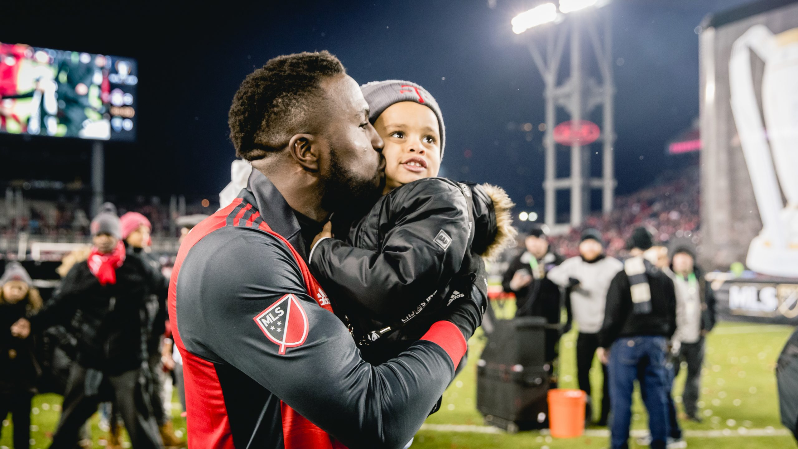
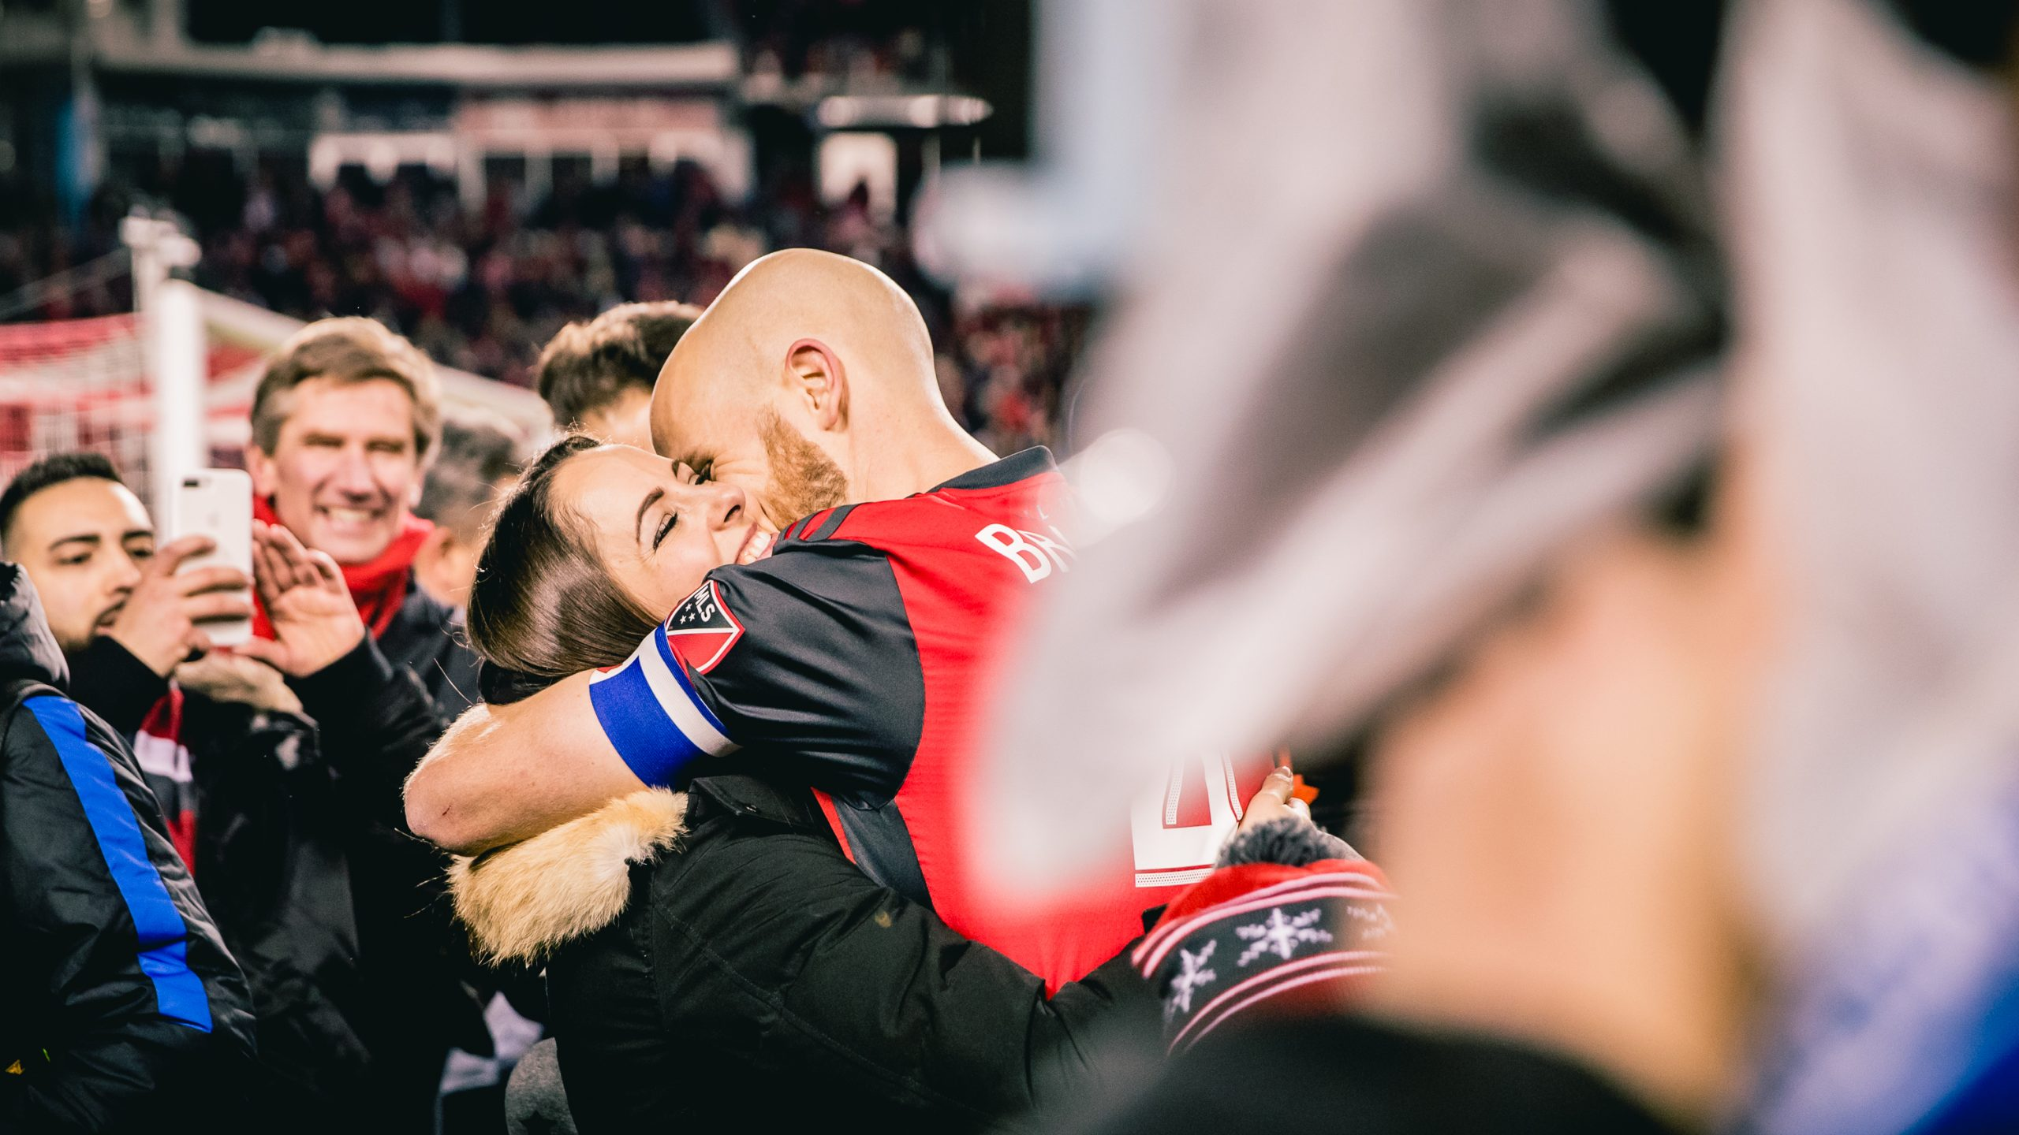
THANK YOU..!!

